Slide 1



Exercise Fahrenheit 2024
NEC Assurance Exercise
Post Exercise Report
Network
Emergency
Co-ordinator
Next
Page

Slide 2
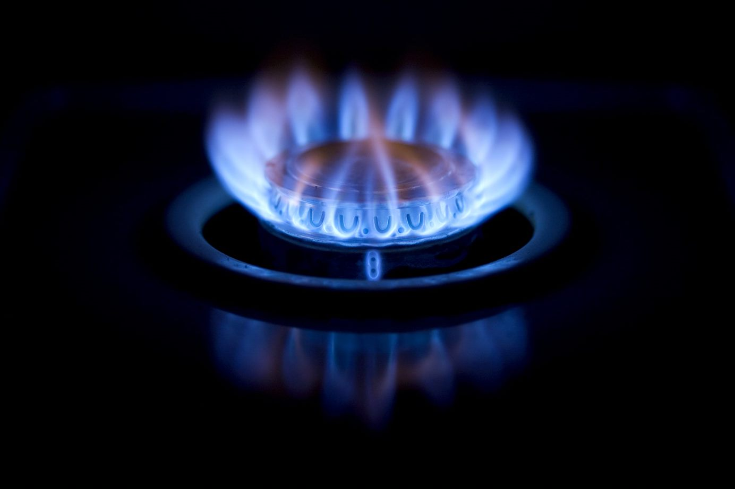
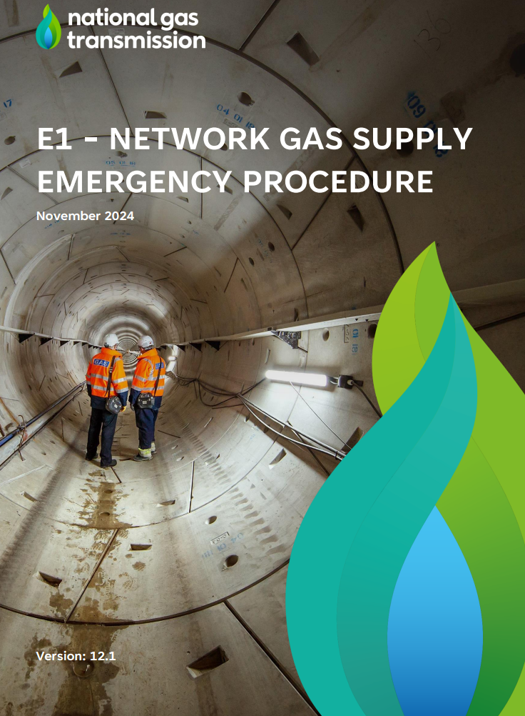
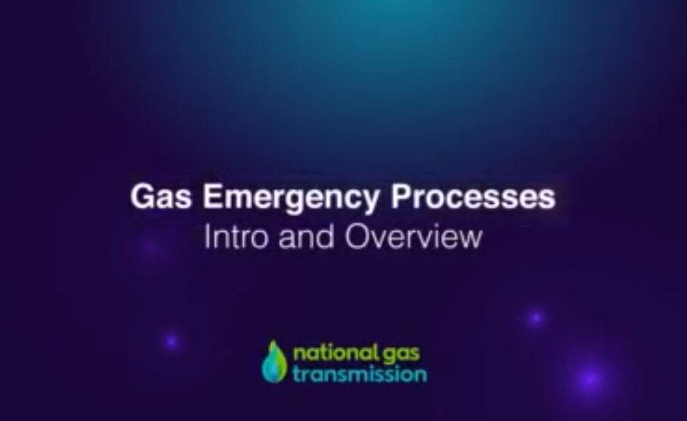



NEC Industry Exercise Fahrenheit 2024 Post Exercise Report
Exercise ‘Fahrenheit’ was the Gas Industry’s annual Network Gas Supply Emergency (NGSE) Network Emergency Co-ordinator (NEC) assurance exercise.
The ‘E1 Network Gas Supply Emergency Procedure’ sets out how an NGSE is managed. Version 12.1 was published in November 2024. Click the image on the left to access this important document
Exercise Scope >
Executive Summary >
This report has been authored by the Office of the NEC. It serves as a record of NEC Industry Exercise Fahrenheit 2024.
Key Areas:
NGSE Strategy
Gas Transporter Interactions
Load Shedding
Gas and Electricity Interactions
Click the image on the right to watch a short video which explains the Emergency Framework
Public Communications
Managing Supply
Learning Points>
Progress since 2023 Ex Everest >
Appendices >
This is an interactive document. The buttons below feature on the left bottom corner of each page for your convenience. Use them as follows:
Home: takes you back to this page
Glossary: Link to abbreviations and definitions
Navigation: takes you to the next or previous page

Slide 3
NEC Industry Exercise Fahrenheit 2024 Post Exercise Report
Exercise Scope
Exercise Scope >
The NEC Safety Case requires the NEC to develop and deliver an annual exercise.
The overriding aim of the exercise is to demonstrate to the NEC that the Gas Industry is prepared and able to meet its obligations in the event of a NGSE. The NEC is obligated to review the industry exercise to: assure the objectives were met; outline any lessons identified; action areas for development; and publish the results of the review in a report to the Health and Safety Executive (HSE), which is then shared with industry. Full details of the exercise aim and objectives can be found in Appendix 3. This year’s exercise objectives were met, though learning points have been identified, which are summarised in the Learning Points section of this report. Exercise Fahrenheit took place over three days to the scope detailed below:
Executive Summary >
Key Areas:
NGSE Strategy
Gas Transporter Interactions
Load Shedding
Stage 1: admission of ‘emergency specification gas’
Stage 2: entry point flow directions
Stage 2: load shedding directions
Public Appeal
Thursday 10th October
Pre-Emergency
Friday 11th October
Emergency
Wednesday 16th October
Isolation
Gas Balancing Notification
Gas Availability Status (GAS) report
Scale-back off-peak exit capacity
Activation of Operating Margins contracts
Stage 1: admission of ‘emergency specification gas'
Stage 2: Priority customer load shedding directions
Public Appeal Press Conference
Stage 3: allocation and isolation
Gas and Electricity Interactions
Public Communications
Managing Supply
Learning Points>
Progress since 2023 Ex Everest >
Appendices >

Slide 4
NEC Industry Exercise Fahrenheit 2024 Post Exercise Report
The overriding aim of the exercise was to demonstrate to the NEC that the Gas Industry is prepared and able to meet its obligations in the event of a NGSE.
Exercise Fahrenheit continued improving levels of participation across the Gas Industry. Over 400 individuals across more than 50 organisations took part, which allowed the opportunity to exercise processes and interactions across the energy sector. This level of participation also allowed for increased realism and provided opportunities for the responders to work through the challenges this can bring.
Exercise Scope >
Executive Summary >
NGSE Strategy
The complexity of developing an NGSE strategy continues to grow, however, significant improvements to the NGSE framework have strengthened the ability to manage the strategy effectively. Collaboration and shared understanding are now more crucial than ever for ensuring a safe and efficient response.
Gas and Electricity Interactions
Substantial progress has been made to further embed the processes for interaction between GSO and NESO. Further effort is now required to fully assure that load shedding does not trigger electricity system instability.
Key Areas:
NGSE Strategy
Gas Transporter Interactions
Load Shedding
Gas and Electricity Interactions
Gas Transporter Interactions
The modernisation of information sharing and ongoing efforts to collaborate on process improvements have accelerated response times in key interactions between Gas Transporters. Modern technologies are now required to analyse the whole system implications of a shortage of gas.
Public Comms
The process for the issue of an NEC Public Appeal has been modernised and embedded. Communications teams have made good progress against long standing learning points. New arrangements for communications coordination must be tested before the move of Gas Transporters from the ENA to FEN in January ‘25.
Public Communications
Managing Supply
Learning Points>
Load Shedding
Testing the load shedding process on the NTS demonstrated a stable performance, recognising the intricacies in timings around sites which are required to prevent a National Power Outage. This makes the LDZ performance even more important but data within the LDZs is indicating a continued downward trend.
Managing Supply
A refined process for ascertaining Gas Availability Status information was successfully tested, allowing the NSTA G.A.S portal to be decommissioned in favour of a more agile approach.
Progress since 2023 Ex Everest >
Appendices >

Slide 5
NGSE Strategy
NEC Industry Exercise Fahrenheit 2024 Post Exercise Report
Exercise Scope >
The complexity of developing an NGSE strategy continues to grow, however, significant improvements to the NGSE framework have strengthened the ability to manage the strategy effectively. Collaboration and shared understanding are now more crucial than ever for ensuring a safe and efficient response.
Executive Summary >
Minimise flows
The Gas Transporters, alongside the Department for Energy Security & Net Zero (DESNZ), have undertaken considerable work to achieve a new capability to direct priority category ‘C’ and ‘B’ customers to minimise their gas demand, before they are directed to cease taking gas completely. Minimise flows directions were delivered during Fahrenheit, and the concept can now be embedded into a live response. The Load Shedding Performance section of this report covers this process in detail.
Isolation
A key objective of this year’s exercise was to provide sufficient time for Gas Distribution Networks to conduct isolation: this was achieved. Focus on the equitable allocation of remaining supply to each GDN enabled a pragmatic management of isolation by the GDNs at source. The Gas Task Group’s Isolation Working Group should continue to optimise how this allocation is directed and deployed.
Senior participation
COBR briefings were fully simulated providing the opportunity for Senior Energy Leaders to deliver clear and effective briefings and respond to questions from government. This was seen to be a positive enhancement to the exercise and should become the standard for future events.
Key Areas:
Notification of an NGSE
The NEC is obligated to inform the Gas Industry (all organisations with a duty under GS(M)R to cooperate with the NEC) upon declaring an NGSE. This process is well tested; however, wider stakeholders, including NESO, do not currently receive this declaration directly. NGSE declarations should be clear, comprehensive and wide reaching.
Timing and validity of response actions
Interactions to share situational awareness and determine whole system impact, between National Gas Transmission (NGT) and organisations such as the Gas Distribution Networks (GDN) and the National Energy System Operator (NESO), are well rehearsed and effective. However, as there are no formal direction shared between NGT and NESO, and therefore there were occasions where organisations acted before receiving a formal direction. There remains an opportunity to modernise information sharing across the energy sector’s response. This solution could include a function for the recording and confirmation of clear directions and other instructions.
There is a further opportunity to continue to mature cross organisational appreciation of the lead times involved in key response actions.
NGSE Strategy
Gas Transporter Interactions
Load Shedding
Gas and Electricity Interactions
Public Communications
Managing Supply
Learning Points>
Progress since 2023 Ex Everest >
Appendices >

Slide 6
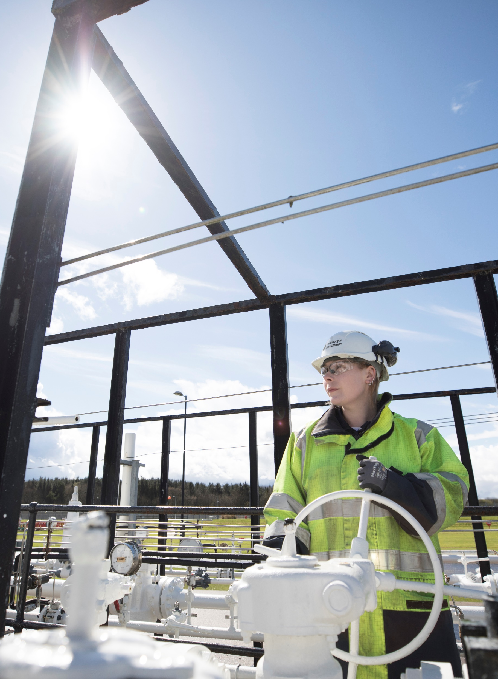

NGSE Strategy
NEC Industry Exercise Fahrenheit 2024 Post Exercise Report
Exercise Scope >
Learning Points
NGSE declarations should be clear, comprehensive and wide reaching across both the gas and electricity sectors.
The delivery of a ‘modernised online approach’ to information sharing between Gas Transporters is still required.
Consideration should be given for the ability of an online approach for issuing directions and instructions.
Continue to mature cross organisational appreciation of the lead times involved in key response actions.
The Gas Task Group’s Isolation Working Group should continue to optimise how isolation allocation is directed and deployed.
Executive Summary >
Key Areas:
NGSE Strategy
Gas Transporter Interactions
Load Shedding
Gas and Electricity Interactions
Public Communications
Managing Supply
Learning Points>
Progress since 2023 Ex Everest >
Appendices >
Relevant Working Groups:
E3 Alignment Group
Gas Task Group
EGRI Task Group

Slide 7
Gas Transporter Interactions
NEC Industry Exercise Fahrenheit 2024 Post Exercise Report
Exercise Scope >
The modernisation of information sharing and ongoing efforts to collaborate on process improvements have accelerated response times in key interactions between Gas Transporters. Modern technologies are now required to analyse the whole system implications of a shortage of gas.
Executive Summary >
Modernisation of information sharing
A full modernisation of the information sharing forms utilised by the Gas Transporters has been undertaken across 2023/24, in readiness for the deployment of an online information sharing portal (as per learning point #2).
Pace of response
The pace of the response between Gas Transporters was improved this year. This is assessed to be thanks to continued collaboration, improvements to process and the successful actioning of lessons identified in previous exercises.
NEC observation
NEC Officers visited the majority of the GDN’s response centres over the course of the exercise. This was agreed by all parties to be hugely valuable. It was an opportunity to share insights into each other's response arrangements. This arrangement should be repeated in future exercises and to potentially include key Network Emergency Management Team (NEMT) staff. It would also be valuable for GDNs to observe the NGT response.
The NEC Officer’s observation was able to pinpoint areas where information sharing could be improved. Any enhancements to the ability to clearly share a common operating picture will further benefit interactions.
GDN and DNO interactions
The exercise continues to feel real, engage participants and present myriad points for ongoing improvement. Further efforts were made this year for GDNs and their associated electricity DNOs to interact. While there have been improvements, further work is still required on this, as at times information was not shared between GDNs and DNOs / IDNOs. Further reflections are required by the GDNs to ascertain what information regarding the converse system would be freely available to distribution operators and what information requires to be actively shared. This work should further feed enhanced analysis of the implications of electricity demand control on the gas network’s demand and physical operation.
Learning Points
There is a requirement for enhanced analysis of the implications of electricity demand control on the gas network’s demand and physical operation.
Further reflections are required by the GDNs to ascertain what information regarding the converse system would be freely available to distribution operators.
Key Areas:
NGSE Strategy
Gas Transporter Interactions
Load Shedding
Gas and Electricity Interactions
Public Communications
Managing Supply
Learning Points>
Progress since 2023 Ex Everest >
Appendices >
Relevant Working Groups:
Gas Task Group
EGRI Task Group
Electricity Task Group

Slide 8
Load Shedding Performance
NEC Industry Exercise Fahrenheit 2024 Post Exercise Report
Exercise Scope >
Testing the load shedding process on the NTS demonstrated a stable performance, recognising the intricacies in timings around sites which are required to prevent a National Power Outage. This makes the LDZ performance even more important but data within the LDZs is indicating a continued downward trend.
Executive Summary >
The NEMT conducted the assurance activity of contacting all sites connected to the NTS, which have an active gas flow, during Exercise Fahrenheit (expanded on page 9). The load shedding performance on the NTS is stable and comparable with previous years.
Testing of the requirement to prevent electricity system instability in the last four years of exercising has required a consistent volume of gas fired generation demand (noting that this requirement can change based on system conditions). Therefore, the new concept of directing Category C & B Priority Customers to minimise flows ahead of a direction to stop taking gas further emphasises the importance of reducing demand while maintaining priority. Efforts will now progress to appropriately categorise sites which are listed as industrial connections in the LDZs but provide heat to domestic consumers.
Over the last five years there has been a continuous downward trend in sites which agree to stop taking gas when directed in the LDZs. There is also an increase, compared to 2023, in the number of sites where ‘contact was made but the site would not stop using gas’. This requires to be analysed and understood in order to action a return to performance percentage as close to 100% as practicable. It is also still assessed that further progress is reliant on the quality of emergency contact information which is passed to the GDNs from Shippers via Xoserve, a long-standing issue which must be solved.
Learning Points
Previous attempts by the GDNs to remind Shippers of the UNC obligation to provide accurate emergency contact information for their industrial sites have not been successful in influencing an improvement. A revised approach is still required.
Work will now commence on the classification, and therefore position in the load shedding hierarchy, for industrial connections which provide heat to domestic consumers.
Key Areas:
NGSE Strategy
Gas Transporter Interactions
Load Shedding
Gas and Electricity Interactions
What is Load Shedding?
Load shedding is the procedure used by Gas Transporters at Stage 2 of an NGSE, to secure a graduated and controlled reduction in demand on all, or part, of their systems to keep the system securely pressurised.
This is achieved by making direct, or indirect, contact with large consumers and legally directing them to stop, or reduce, their consumption of gas, as per the Gas Safety (Management) Regulations 1996.
Public Communications
Managing Supply
Learning Points>
Progress since 2023 Ex Everest >
Appendices >
Relevant Working Groups:
E3 Alignment Group
Gas Task Group

Slide 9
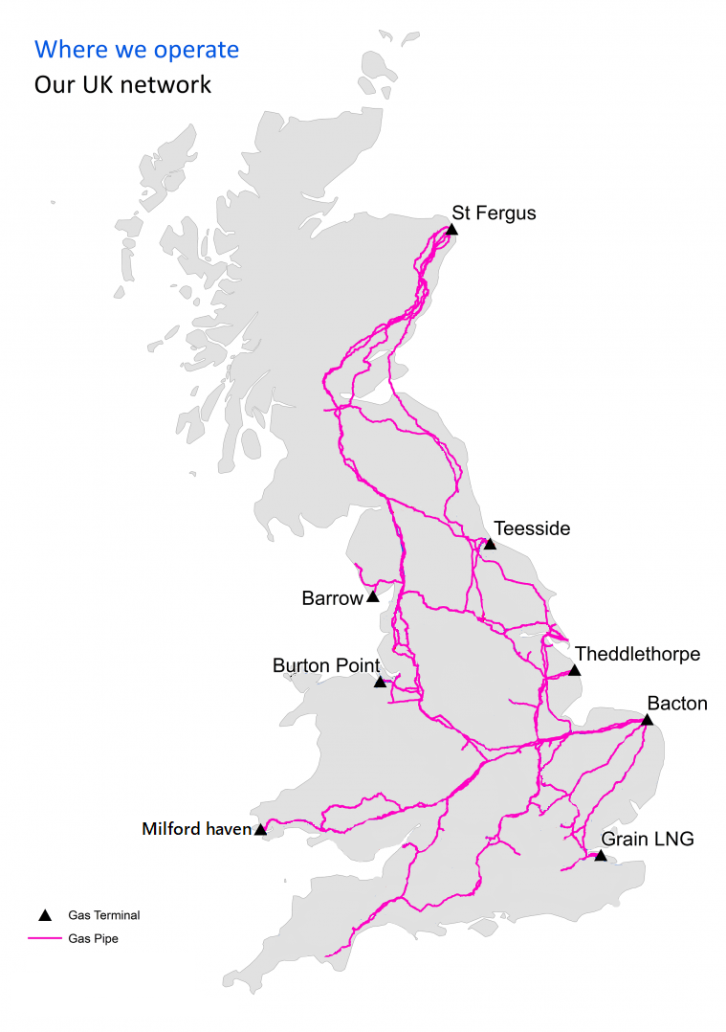
Load Shedding Performance - NTS
NEC Industry Exercise Fahrenheit 2024 Post Exercise Report
Exercise Scope >
There are currently 54 sites directly connected to the NTS. During Exercise Fahrenheit contact was successfully made with all sites.
48 sites confirmed they would cease taking gas within one hour
6 sites took longer than one hour to cease taking gas; however, this was associated with the requirement to maintain a stable electricity system from NESO.
Executive Summary >
The National Transmission System
Key Areas:
NGSE Strategy
Gas Transporter Interactions
Exercise Fahrenheit
Successful Contact | Confirmation site would stop using gas within one hour (excluding those not instructed due to electricity system stability requirements):
100% | 100%
Load Shedding
Gas and Electricity Interactions
Public Communications
Performance history (last 5 years)
Exercise Name and Year of delivery: | Percentage of sites who could be contacted and would stop using gas within one hour:
Fahrenheit 2024 | 89%
Everest 2023 | 98%
Degree 2022 | 93%
Celsius 2021 | 96%
Baltic 2020 | 95%
Managing Supply
Learning Points>
Progress since 2023 Ex Everest >
Appendices >

Slide 10
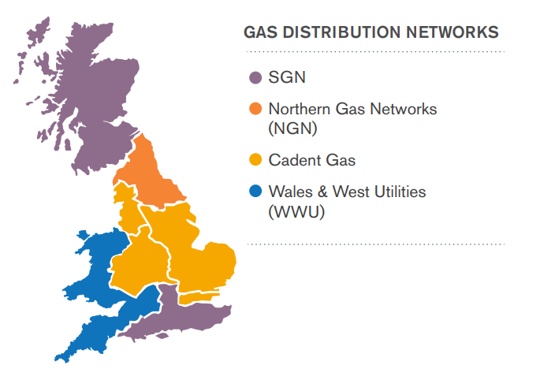
NEC Industry Exercise Fahrenheit 2024 Post Exercise Report
Load Shedding Performance - LDZs
Exercise Scope >
Load shedding performance data within the LDZs is indicating a continued overall downward trend. There is an increase, compared to 2023, in the number of sites where ‘contact was made but the site would not stop using gas’. This requires to be analysed and understood to action a return to performance percentage as close to 100% as practicable.
Executive Summary >
Key Areas:
NGSE Strategy
Gas Transporter Interactions
Load Shedding
Exercise Fahrenheit 2024 – Performance Breakdown
GDN | No. of sites attempted to be contacted | No. of sites where contact was made, and site would stop using gas |  | No. of sites where contact was made, and site would not stop using gas |  | No. of sites who could not be contacted
Cadent | 1000 | 884 | 88.40% | 8 | 0.80% | 165 | 14.73%
NGN | 400 | 333 | 83.25% | 34 | 8.5% | 33 | 8.25%
SGN | 600 | 457 | 76% | 0 | 0% | 143 | 23.83%
WWU | 600 | 600 | 100% | 0 | 0% | 0 | 0%
Performance History (last 5 years)
Exercise Name and Year of delivery | No of sites attempted to be contacted | No of sites where contact was made, and site would stop using gas
Fahrenheit 2024 | 2600 | 2274 | 87%
Everest 2023 | 2600 | 2345 | 90%
Degree 2022 | 2600 | 2319 | 90%
Celsius 2021 | 2600 | 2362 | 91%
Baltic 2020 ¹ | 600 | 572 | 95%
¹The 2020 assurance activity was scaled down to top 50 sites due to COVID-19
Gas and Electricity Interactions
Public Communications
Managing Supply
Learning Points>
Progress since 2023 Ex Everest >
Appendices >

Slide 11
Gas and Electricity Interactions
NEC Industry Exercise Fahrenheit 2024 Post Exercise Report
Exercise Scope >
Substantial progress has been made to further embed the processes for interaction between GSO and NESO. Further effort is now required to fully assure that load shedding does not trigger electricity system instability.
Executive Summary >
Information sharing protocols have undergone further review and are now well embedded and tested. Ofgem and DESNZ have renewed their endorsement of these protocols. The dashboard utilised to support GSO to NESO for information sharing is continually improving and remains to be an effective tool.
Undertaking cross command centre discussion, ascertaining cross network impact and deploying the appropriate response arrangements continues to be a significantly challenging activity. Now that this process is suitably mature the temporary addition of a NESO responder being physically placed within the NEMT requires review.
The NGSE Strategy Section of this report outlined learning on the timing and validity of response actions. This is particularly relevant for the decision to undertake electricity demand control pre-emptive to the deployment of gas fired generation load shedding. Continuous improvement should focus on responders involved in this process to fully understand the lead times and decision points in both organisations' response actions in this space, as per learning point #2.
Though considered mitigations have been deployed, there remains a risk of electricity system instability if the load shedding of gas fired generation by the NEMT, is not appropriately sequenced to the activation of electricity demand control tranches. This topic requires a full review, followed by enhanced participation from gas fired generators in future exercises to test any assumptions. It is recognised that testing of this process in isolation to the major exercise may also be necessary.
Learning Points
A full and detailed review of the process for sequencing the direction for a gas fired generator to cease taking gas without triggering electricity system instability is required.
The most appropriate process to deliver NEC directions to gas fired generators should be determined, with input from generators and NESO.
Key Areas:
NGSE Strategy
Gas Transporter Interactions
Load Shedding
Gas and Electricity Interactions
Public Communications
Managing Supply
Learning Points>
Progress since 2023 Ex Everest >
Appendices >
Relevant Working Groups:
EGRI Task Group
Electricity Task Group

Slide 12
Public Communications
NEC Industry Exercise Fahrenheit 2024 Post Exercise Report
Exercise Scope >
The process for the issue of an NEC Public Appeal has been modernised and embedded. Communications teams have made good progress against long standing learning points. New arrangements for communications coordination must be tested before the move of Gas Transporters from the ENA to FEN in January ‘25.
Executive Summary >
Public Appeals Policy
In January ‘24, the NEC published a Public Appeals Policy to bring clarity to how and when they will issue a public appeal and to Direct Gas Transporters to author their own Public Appeal Procedure (NGT) or Plan (GDNs). This was fully tested during Exercise Fahrenheit.
Primacy in press conferences
Part of the successful simulation of a public appeal was the deployment of a series of press conferences. These are undertaken jointly between the NGT and NESO plus the NEC, where appropriate. Both NGT and NESO have effective procedures for briefing the public via the press. Further work is however required to better define primacy when there are both gas and electricity disconnections occurring, with different timeframes. Consideration should be given to whether the sequencing of conferences can be predetermined when there is a gas supply shortage leading to electricity demand control.
Future changes
Gas Transporters will cease to be members of the Energy Networks Association (ENA) in January ‘25, at which point the coordination of Gas Transporter communications will be delivered by Future Energy Networks (FEN). All communication services previously provided by
the ENA have been replicated into FEN processes, and should be fully tested in advance of January ’25
The creation of FEN has also enabled Gas Transporters to work at pace in the creation of a high-capacity website for gas consumer information. This will enable the deployment of consistent information on mass to the public during a gas supply shortage. The use of this platform should be a feature of the 2025 NEC Industry Exercise. An NEC website is also in development and will complement the messaging of FEN’s high-capacity website.
Learning Points
Further work is now required to confirm the likely timings and primacy of communications during a gas supply shortage with associated electricity demand control measures.
Key Areas:
NGSE Strategy
Gas Transporter Interactions
Load Shedding
Gas and Electricity Interactions
Public Communications
Managing Supply
Learning Points>
Progress since 2023 Ex Everest >
Appendices >
Relevant Working Group
Communications Task Group

Slide 13
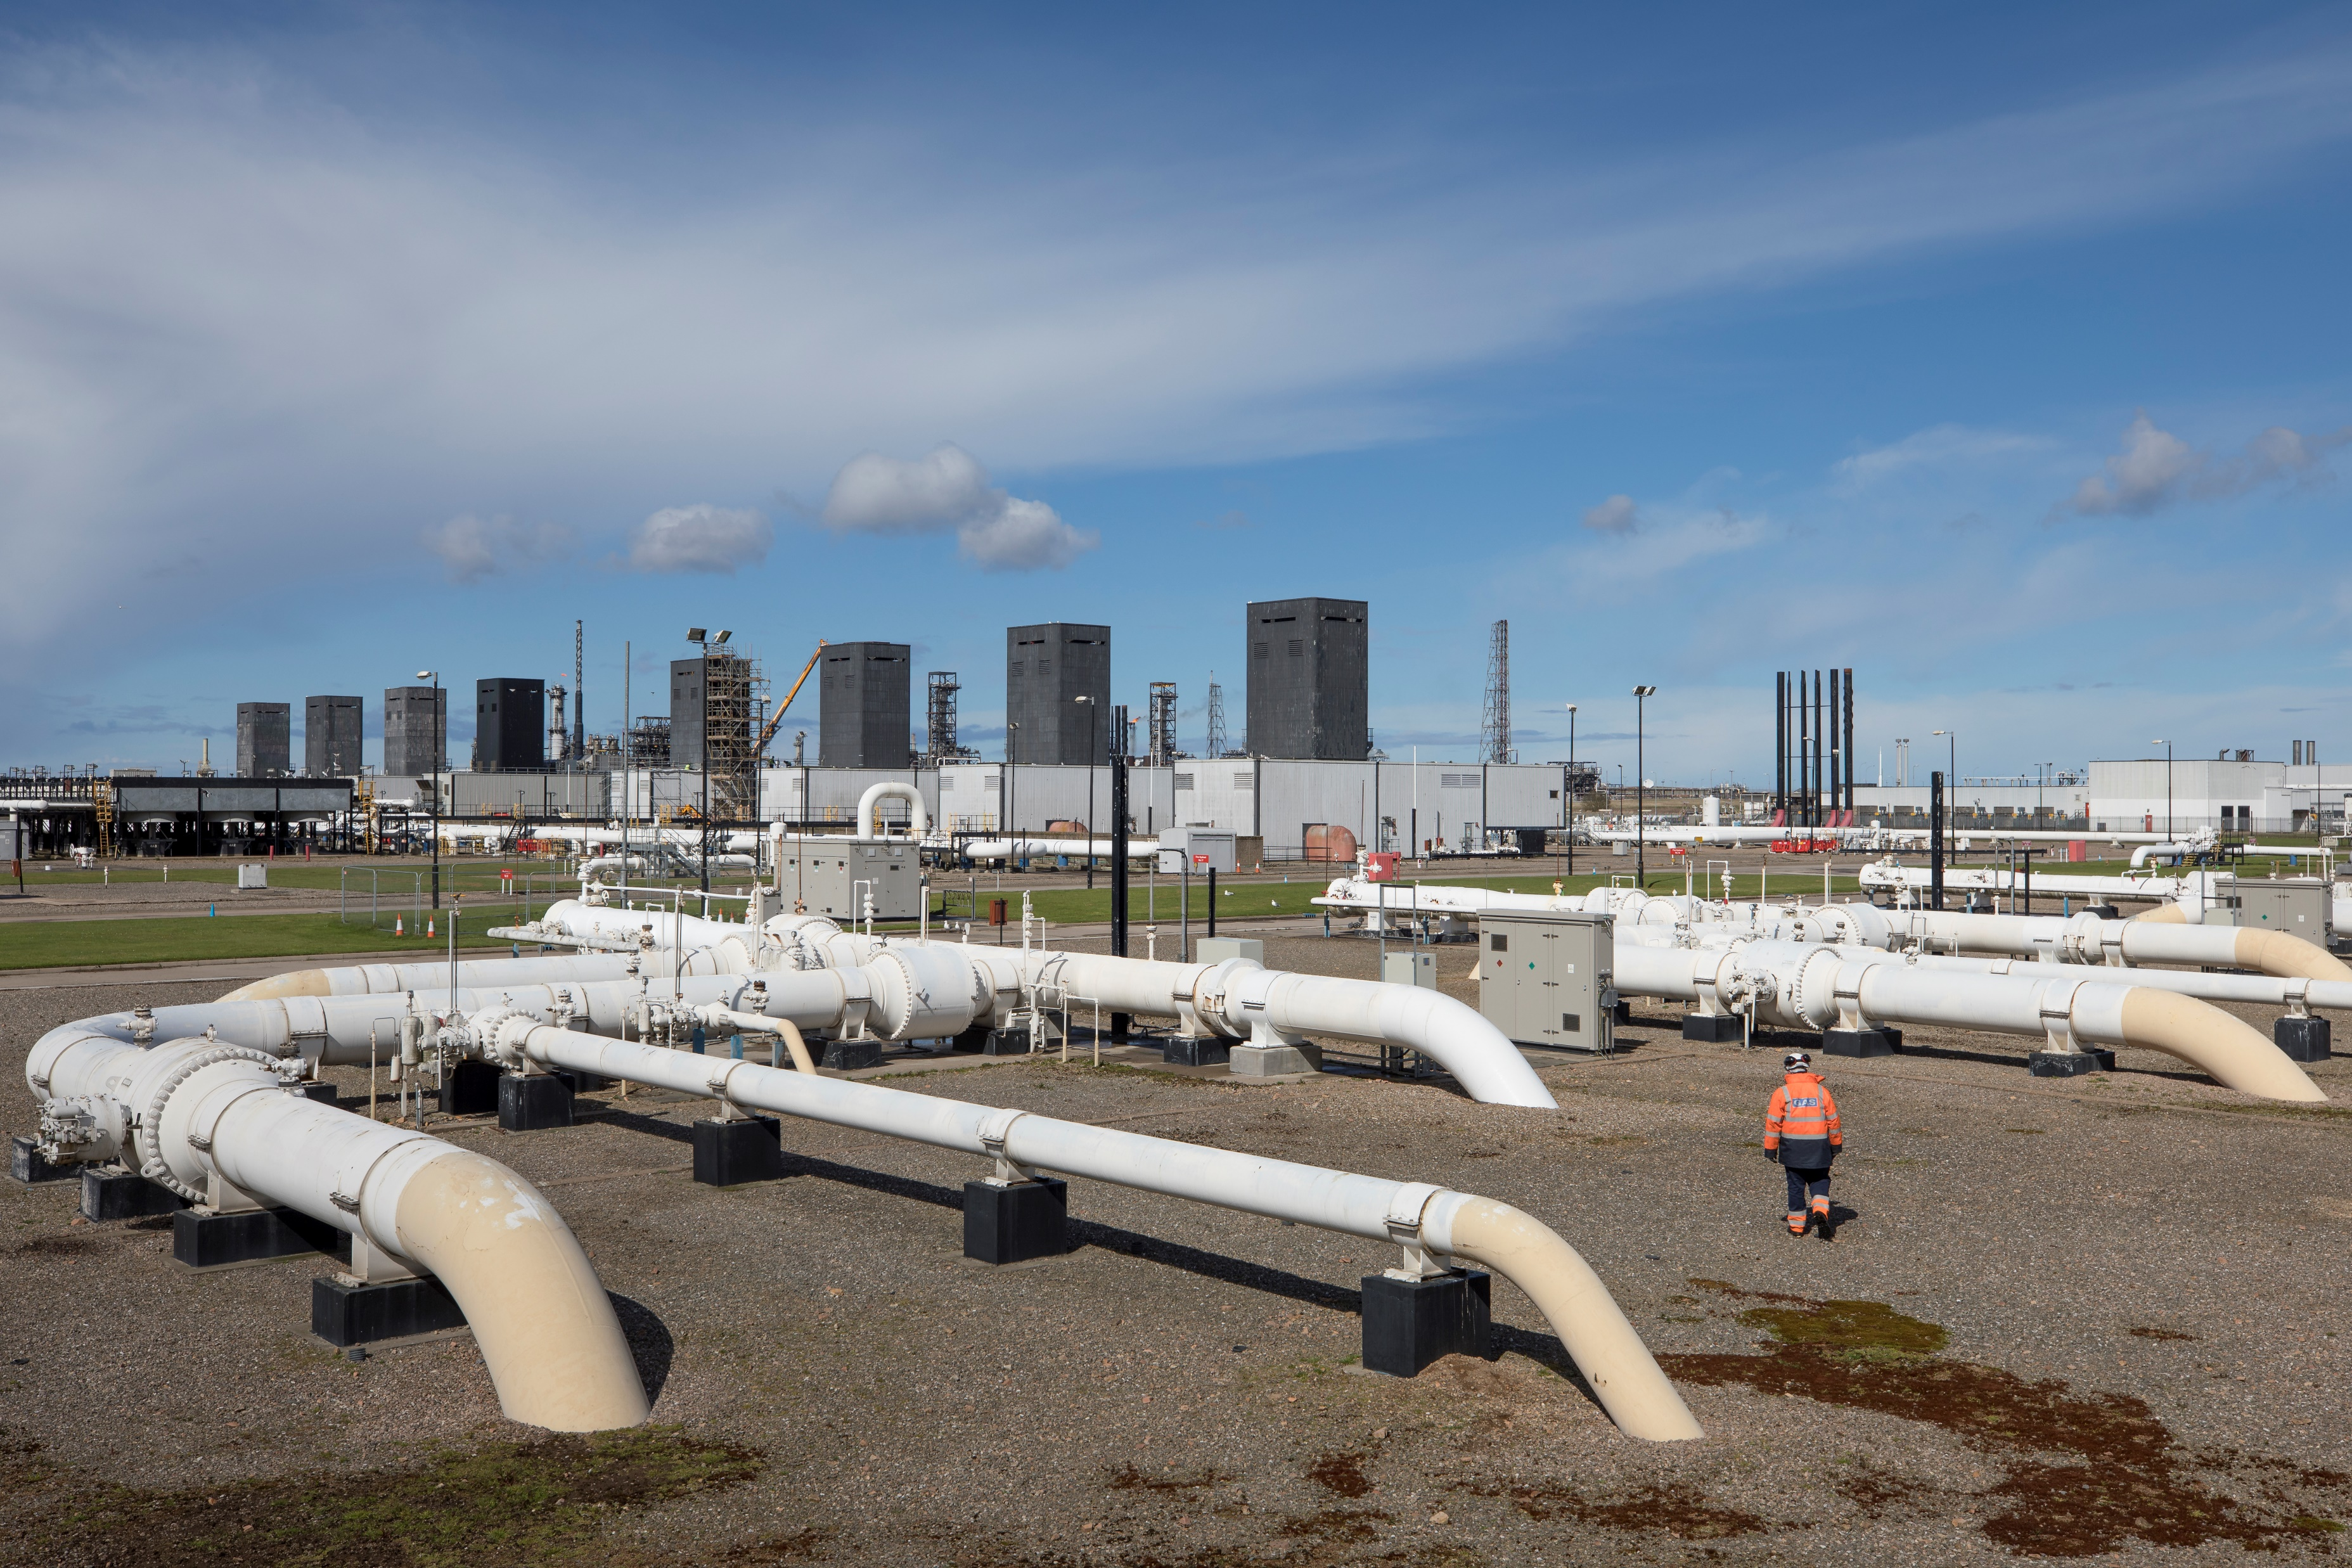
Managing Supply
NEC Industry Exercise Fahrenheit 2024 Post Exercise Report
Exercise Scope >
A refined process for ascertaining Gas Availability Status information was successfully tested, allowing the NSTA G.A.S portal to be decommissioned in favour of a more agile approach.
Executive Summary >
Key Areas:
This refined approach involves issuing a digital form to Terminal Operators which contains the Gas Availability Status questions. Completing this form does not require a password or username, enabling Terminal Operators to focus on the detail of their submission versus the navigation of an online system they rarely use.
This new approach saw all but one terminal respond to the request for information within one hour. The new approach also allows NGT to embed a more consistent procedure across storage sites and other supply sites not covered by the North Sea Transition Authority's memorandum of understanding.
NGT will now embed this refined process for future use.
NGSE Strategy
Gas Transporter Interactions
Load Shedding
Gas and Electricity Interactions
Public Communications
Managing Supply
Learning Points>
Progress since 2023 Ex Everest >
Appendices >

Slide 14
Summary of Learning Points
NEC Industry Exercise Fahrenheit 2024 Post Exercise Report
Exercise Scope >
The 10 learning points arising from Exercise Fahrenheit are detailed below. These will be reviewed, and action plans progressed by the relevant industry group. The Office of the NEC shall report progress against the actions to address each learning point through the bi-annual assurance report, and in regular NEC liaison meetings.
Executive Summary >
NGSE Strategy (various working groups)
NGSE declarations should be clear, comprehensive and wide reaching across both the gas and electricity sectors.
The delivery of a ‘modernised online approach’ to information sharing between Gas Transporters is still required.
Consideration should be given for the ability of an online approach for issuing directions and instructions.
Continue to mature cross organisational appreciation of the lead times involved in key response actions.
The Gas Task Group’s Isolation Working Group should continue to optimise how isolation allocation is directed and deployed.
Gas Transporter Interactions (various working groups)
There is a requirement for enhanced analysis of the implications of electricity demand control on the gas network’s demand and physical operation.
Further reflections are required by the GDNs to ascertain what information regarding the converse system would be freely available to distribution operators.
Load Shedding (E3 Alignment Group, Gas Task Group)
Previous attempts by the GDNs to remind Shippers of the UNC obligation to provide accurate emergency contact information for their industrial sites have not been successful in influencing an improvement. A revised approach is still required.
Work will now commence on the classification, and therefore position in the load shedding hierarchy, for industrial connections which provide heat to domestic consumers.
Key Areas:
NGSE Strategy
Gas Transporter Interactions
Load Shedding
Gas and Electricity Interactions
Public Communications
Managing Supply
Learning Points>
Progress since 2023 Ex Everest >
Appendices >

Slide 15
Summary of Learning Points
NEC Industry Exercise Fahrenheit 2024 Post Exercise Report
Exercise Scope >
Gas and Electricity Interactions (Electricity and Gas Resilience Interactions Task Group & Electricity Task Group)
A full and detailed review of the process for sequencing the direction for a gas fired generator to cease taking gas without triggering electricity system instability is required.
The most appropriate process to deliver NEC directions to gas fired generators should be determined, with input from generators and NESO.
Public Communications (Communications Task group)
Further work is now required to confirm the likely timings and primacy of communications during a gas supply shortage with associated electricity demand control measures.
Managing Supply
None
Executive Summary >
Key Areas:
NGSE Strategy
Gas Transporter Interactions
Load Shedding
Gas and Electricity Interactions
Public Communications
Managing Supply
Learning Points>
Progress since 2023 Ex Everest >
Appendices >

Slide 16
Progress Since Exercise ‘Everest’ (2023)
NEC Industry Exercise Fahrenheit 2024 Post Exercise Report
Exercise Scope >
The learning points arising from the 2023 NEC Industry Exercise ‘Everest’ are set out in the following table, along with a progress statement and completion status.
Where a learning point has been marked as complete, this does not mean that it should not be revisited, or the learning utilised to inform a similar area, or alternate process.
Where a learning point is marked as ongoing, the learning point from this year’s report (Ex Fahrenheit) is referenced to demonstrate that understanding is developing, and progress has been made since the original identification of this learning.
Out of the 20 learning points arising from Exercise ‘Everest’, 12 are considered complete and 8 are ongoing due to the scale of the work scope (see progress statements for further detail).
Executive Summary >
Key Areas:
NGSE Strategy
Gas Transporter Interactions
Load Shedding
Learning Points From Exercise Everest | Progress | Status
NGSE Strategy
1. The NEC would benefit from further data relating to Priority Customers across the network when making the decision to direct them to be load shed. | Action was agreed at the E3AG meeting. NGT to seek whole network information from Xoserve with GDN's permission to view. NGT will share findings with NECs at scheduled quarterly meetings to gain their reflections on the quality of the information – there are complexities around the ability for Xoserve to share certain types of customer information, the Office of the NEC will submit a further request that Xoserve provide sufficient information and provide assurance with regards to how the information will be used and stored. | Ongoing Fahrenheit LP #8
2. The ability for the GDNs to avoid isolating Category A Priority Customers when undertaking isolation should be explored, to allow flexibility in the decision to alter the load shedding strategy. | The NEC Office achieved endorsement from the NEC that the absence of a direction to load shed Priority A customers does not require GDNs to protect these sites from isolation, unless explicitly directed by the NEC or the SoS through an order in Privy Council. The NEC shall retain the flexibility to move to isolation without load shedding Priority A customers should the strategy and conditions favour this approach. A contemporary research project is now being considered to modernise and validate the safety implications arising from a loss of pressure against the threat to life which exists amongst Priority A customers. | Complete
Gas and Electricity Interactions
Public Communications
Managing Supply
Learning Points>
Progress since 2023 Ex Everest >
Appendices >

Slide 17
Progress Since Exercise ‘Everest’ (2023)
NEC Industry Exercise Fahrenheit 2024 Post Exercise Report
Exercise Scope >
Learning Points From Exercise Everest | Progress | Status
NGSE Strategy
3. Remedial action is required to assure the Supplementary Transporters, which operate Supplementary Systems, are a core element of NGSE response activities, actively feeding into strategy formation and that they are included in future exercises. | IGTs were actively involved in Exercise Fahrenheit and will be invited to participate in future exercises, progress in this area will be monitored in exercises scheduled for 2025. | Complete
4. Further clarification is required to refine the interaction protocol between DESNZ and the NEC, to ensure appropriate engagement between parties in response activities. | This protocol was renewed for winter 24/25 in collaboration between NGT, the Office of the NCC, DESNZ and the HSE. The protocol was tested and validated during Exercise Fahrenheit wit h no further learnings identified. | Complete
5. Work already undertaken to proceduralise a direction for the NEC to instruct Priority Customers to ‘minimise flows’, requires to be presented to the relevant stakeholder groups for awareness, with a view to making the required changes and to allow testing in the 2024 exercise. | This arrangement is now fully embedded into industry process with all relevant customers informed of the changes and the process to issue a minimise flows direction tested during exercise Fahrenheit. The E1 Network Gas Supply Emergency procedure has been updated to version 12.1 to reflect this change. | Complete
Executive Summary >
Key Areas:
NGSE Strategy
Gas Transporter Interactions
Load Shedding
Gas and Electricity Interactions
Public Communications
Managing Supply
Learning Points>
Progress since 2023 Ex Everest >
Appendices >

Slide 18
Progress Since Exercise ‘Everest’ (2023)
NEC Industry Exercise Fahrenheit 2024 Post Exercise Report
Exercise Scope >
Learning Points From Exercise Everest | Progress | Status
Gas Transporter Interactions
6. A review of the approach to deciding emergency pressures, with a view to reducing spikes, would be beneficial to ensuring proportionate actions are deployed. | The pace of information sharing during Exercise Fahrenheit demonstrated progression on this topic. The development of mutual understanding of the operational complexities of the networks has aided pragmatism to be applied to both further reduce emergency pressure but also to understand the limits of certain offtakes. | Complete
7. The calculation of load shedding returns is less accurate at times of weather extremities, so the process should be reviewed. | The process for calculating returns from load shedding in the LDZs has been calibrated to assure consistency in approach. A load shedding workshop was undertaken in July to refresh Gas Transporters’ understanding of the NGSE Framework approach to load shedding. NGSE Demand Direction forms has been modernised to aid understanding of and clarity in load shedding directions. | Complete
8. Pre-emptive sharing of data and information requires enhancement to support the pace of the formation of an emergency strategy. | This action encouraged continued collaboration. Across 23/24 the following was delivered. * NGT CTC Visits * NETMAN 1 & CTC Exercises * Load Shedding Workshop * Isolation Workshops * ESO Demand Control Briefing * Demand Form redesign * Minimise Flows Project | Complete
Executive Summary >
Key Areas:
NGSE Strategy
Gas Transporter Interactions
Load Shedding
Gas and Electricity Interactions
Public Communications
Managing Supply
Learning Points>
Progress since 2024 Ex Everest >
Appendices >

Slide 19
Progress Since Exercise ‘Everest’ (2023)
NEC Industry Exercise Fahrenheit 2024 Post Exercise Report
Exercise Scope >
Learning Points From Exercise Everest | Progress | Status
Gas Transporter Interactions
9. The forms used to share information and record NEC directions would benefit from modernisation with a view to ensuring they are more flexible. | NGT have fully redesigned the suite of demand information sharing and direction forms in full collaboration with the GDNs. Further learnings have arisen from their detailed testing in Fahrenheit, but the forms are now modernised, sufficiently flexible and will serve as a positive foundation for the building of an online portal. | Complete
10. A modernised online approach to information sharing would benefit the response, though it is appreciated this will be a long-term project. | This learning point was marked as a long-term project. It has been important to complete the above demand form redesigned actions to establish a firm foundation for the portal's design. A full review of the Resilience Direct platform will now be undertaken to assess its suitability for use. Learning Point #2 of this Exercise Fahrenheit Report carries forward this Everest learning point. | Ongoing Fahrenheit LP #2
11. Interactions between GDNs and DNOs require planning to harness the value in sharing the outcome of demand control activities. | Effective interactions have taken place in this space. The recommencing of the EGRI Task Group will further support these discussion moving forward. Learning Point #6 of this Exercise Fahrenheit Report carries forward this Everest learning point. | Ongoing Fahrenheit LP #6
12. An updated study on the impact of electricity demand control on gas demand would support isolation planning in the Gas LDZs. | Learning Point #6 of this Exercise Fahrenheit Report carries forward this Everest learning point. | Ongoing Fahrenheit LP #6
13. The Office of the NEC will review the scope of the Industry Exercise with a view ensuring sufficient response time is spent on Stage 3 considerations, whilst also reviewing the use of live data and the delivery date of the event. | This was fully undertaken leading to the exercise date moved away from first week of winter. A scope sufficient to allow for stage 3 through use of simulated data was achieved and delivered. | Complete
Executive Summary >
Key Areas:
NGSE Strategy
Gas Transporter Interactions
Load Shedding
Gas and Electricity Interactions
Public Communications
Managing Supply
Learning Points>
Progress since 2023 Ex Everest >
Appendices >

Slide 20
Progress Since Exercise ‘Everest’ (2023)
NEC Industry Exercise Fahrenheit 2024 Post Exercise Report
Exercise Scope >
Learning Points From Exercise Everest | Progress | Status
Load Shedding
14. Previous attempts by the GDNs to remind Shippers of the UNC obligation to provide accurate emergency contact information for their industrial sites have not been successful in influencing an improvement. A revised approach is required. | Learning Point #8 of this Exercise Fahrenheit Report carries forward this Everest learning point. | Ongoing Fahrenheit LP #8
15. Clarity is required in E1 on the classification, and therefore position in the load shedding hierarchy, for industrial connections which provide heat to domestic consumers. | Learning Point #9 of this Exercise Fahrenheit Report carries forward this Everest learning point. This work scope is already well embedded onto the Gas Task Group’s work plan. Enhanced processes in this space, which will likely involve an additional priority customer category being defined by Secretary of State, should be ready for testing in the 2025 NEC Industry Exercise. | Ongoing Fahrenheit LP #9
Executive Summary >
Key Areas:
NGSE Strategy
Gas Transporter Interactions
Load Shedding
Gas and Electricity Interactions
Public Communications
Managing Supply
Learning Points>
Progress since 2023 Ex Everest >
Appendices >

Slide 21
Progress Since Exercise ‘Everest’ (2023)
NEC Industry Exercise Fahrenheit 2024 Post Exercise Report
Exercise Scope >
Learning Points From Exercise Everest | Progress | Status
Gas and Electricity Interactions
16. The information sharing protocols between GSO and ESO require review to ensure a clear mechanism for ESO undertaking action on the Electricity System for the benefit of the Whole Energy System | Information sharing protocols have undergone further review and are now well embedded and tested. Ofgem and DESNZ have renewed their endorsement of these protocols. The dashboard which is utilised to support GSO to NESO for information sharing is continually improving and continues to be an effective tool. | Complete
17. There remains an opportunity to increase the efficiency of load shedding gas fired power stations directly connected to the NTS whilst avoiding Electricity System instability. This requires the exploration of an enhanced role for the ENCC in the load shedding process. | Though well thought through mitigations have been deployed, there remains a risk of electricity system instability if the load shedding of gas fired generation is not appropriately sequenced to the activation of electricity demand control tranches. Learning Point #8 & 9 of this Exercise Fahrenheit Report carries forward this Everest learning point. | Ongoing Fahrenheit LP #8 & 9
Executive Summary >
Key Areas:
NGSE Strategy
Gas Transporter Interactions
Load Shedding
Gas and Electricity Interactions
Public Communications
Managing Supply
Learning Points>
Progress since 2023 Ex Everest >
Appendices >

Slide 22
Progress Since Exercise ‘Everest’ (2023)
NEC Industry Exercise Fahrenheit 2024 Post Exercise Report
Exercise Scope >
Learning Points From Exercise Everest | Progress | Status
Public Communications
18. The modernised Public Appeals process now requires embedding, with a view to assuring full clarity in the messaging and the undertaking of consumer testing. | In January ‘24 the NEC created a Public Appeals Policy to bring clarity to how and when they will issue a public appeal and to Direct Gas Transporters to author their own Public Appeal Procedure (NGT) or Plan (GDNs). This clarity has enabled increased engagement in this area which led to a full simulation of the issue of a public appeal during Exercise Fahrenheit. | Complete
19. There remains a pressing requirement to complete the development of information graphics and media lines, which includes consumer advice which is cognisant of ‘whole energy system’ impact. This should be supported by the population of the gas pages of the ‘UK Energy Outage’ website. |  | Complete
20. It is still recommended that Communication Teams undertake standalone exercises to improve and refine the outcomes of these learning points, alongside other CTG work scopes, to mature organisational learning outside of the NEC Industry Exercise [The Communications Task Group has scheduled such events for January and March 2024]. | A Communications Task Group exercise was undertaken on 16th May . A further exercise is planned 19th November ’24, per the narrative in this report on the introduction of FEN. | Complete
Executive Summary >
Key Areas:
NGSE Strategy
Gas Transporter Interactions
Load Shedding
Gas and Electricity Interactions
Public Communications
Managing Supply
Learning Points>
Progress since 2023 Ex Everest >
Appendices >

Slide 23
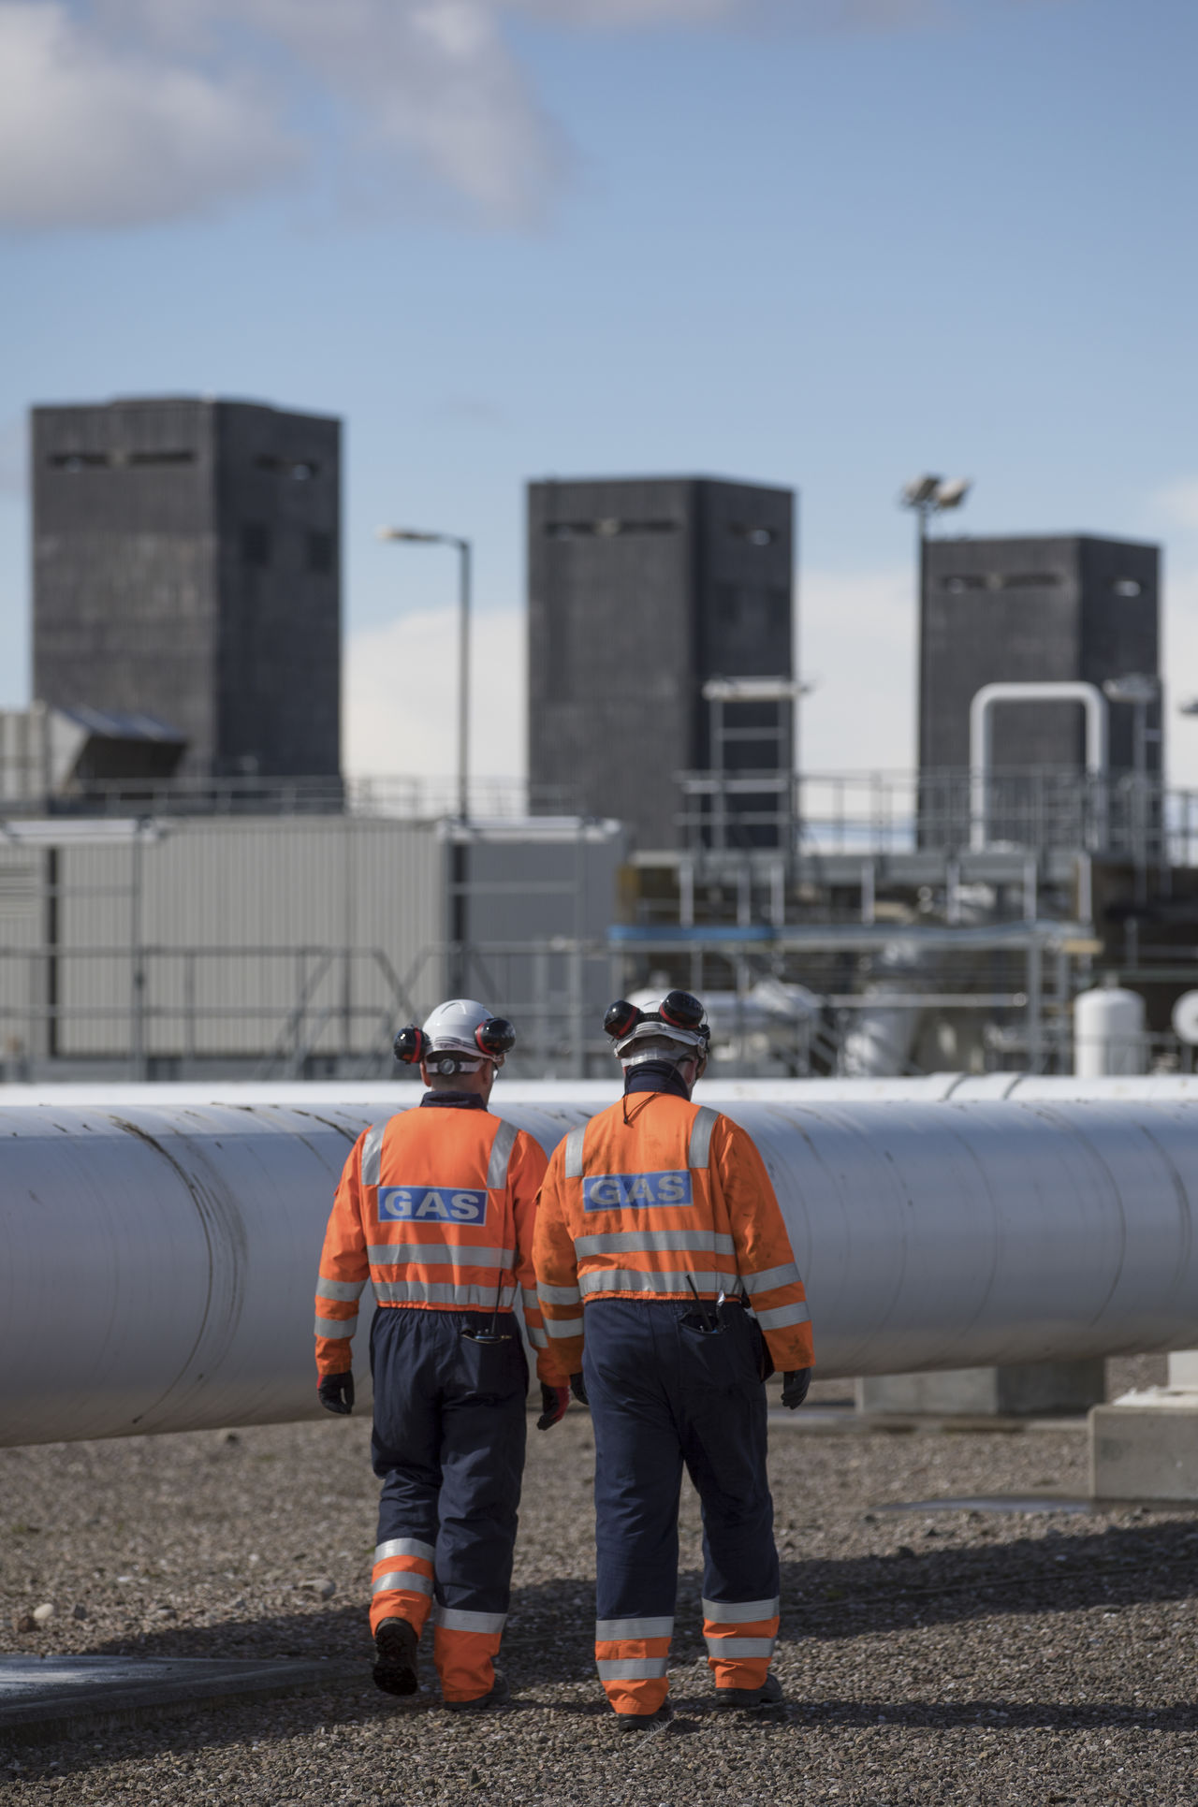
Appendices
NEC Industry Exercise Fahrenheit 2024 Post Exercise Report
Exercise Scope >
Executive Summary >
1
Exercise Participants
Key Areas:
NGSE Strategy
The NEC
2
Gas Transporter Interactions
Load Shedding
3
Exercise Aim and Objectives
Gas and Electricity Interactions
Public Communications
4
List of Abbreviations and Definitions
Managing Supply
5
Industry Working Groups
Learning Points>
Progress since 2023 Ex Everest >
6
Priority Customers
Appendices >

Slide 24
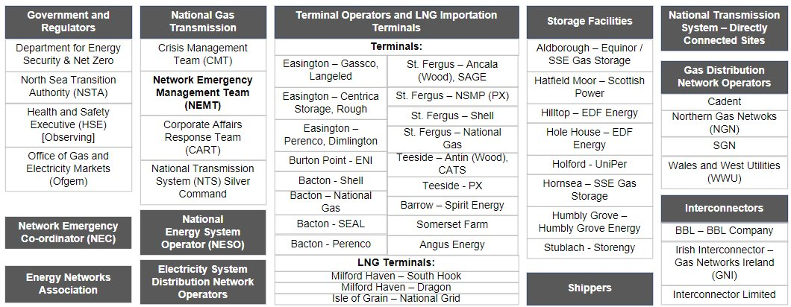
Appendix 1 – Exercise Participants
NEC Industry Exercise Fahrenheit 2024 Post Exercise Report
Exercise Scope >
The NEC Office estimates that over 400 industry participants took part in Exercise Fahrenheit from a range of areas, as illustrated here:
Executive Summary >
Key Areas:
NGSE Strategy
Gas Transporter Interactions
Load Shedding
Gas and Electricity Interactions
Public Communications
Managing Supply
Learning Points>
Progress since 2023 Ex Everest >
Appendices >

Slide 25

Appendix 2 – The NEC
NEC Industry Exercise Fahrenheit 2024 Post Exercise Report
Exercise Scope >
Executive Summary >
The Network Emergency Co-ordinator (NEC) is an independent industry role, established under the Gas Safety (Management) Regulations (GS(M)R) 1996, whose duty is to co-ordinate the actions across affected points of the Gas Network to prevent or minimise the consequences of a Network Gas Supply Emergency (NGSE). This is defined as “an emergency endangering persons arising from a loss of pressure in a network, or part thereof”.
The role of the NEC is currently undertaken by National Gas and is independent from any commercial interests of any organisation within the Gas Industry.
Industry participants such as Transporters and Shippers have a legal duty to cooperate with the NEC, who has the powers to direct the defined duty holders. The arrangements and procedures in place to facilitate these powers are tested annually and this report covers the NEC Industry Exercise 2024, namely ‘Exercise Fahrenheit’.
Key Areas:
NGSE Strategy
Gas Transporter Interactions
Network
Load Shedding
Emergency
Gas and Electricity Interactions
Co-ordinator
Public Communications
Managing Supply
Learning Points>
Progress since 2023 Ex Everest >
Appendices >

Slide 26
Appendix 3 – Exercise Aim and Objectives
NEC Industry Exercise Fahrenheit 2024 Post Exercise Report
Exercise Scope >
The aim of this exercise is to demonstrate that the Gas Industry is prepared and able to meet its obligations in the event of a Network Gas Supply Emergency. This will be demonstrated by effective two-way communication processes across the industry and its stakeholders; timely and accurate information being shared between participants; and effective emergency strategies being produced and implemented.
In achieving this demonstration, the following objectives will be met:
Test the management of an emerging gas supply shortage, using warning notices and the establishment of proactive communication channels, then gain an understanding of how these are received by industry (post exercise).
Test the development and delivery of the pre-emergency strategy, through:
the simulated activation of all viable commercial and physical tools.
the capability of the Primary Transporter to form an accurate situational awareness through industry collaboration.
Practice and enhance processes and tools associated with the interactions between gas and electricity organisations during times of whole energy system stress, supported by active participation from the National Energy System Operator and Electricity Distribution Network Operators.
Test industry’s ability to warn and inform the public through participation of Corporate Affairs’ representatives from the Energy Networks Association, Gas Transporters, the National Energy System Operator and Electricity Network Operators, including changes made to modernise the Public Appeals process.
Test that recommendations from previous industry emergency exercises have been delivered and are effective.
Validate emergency procedures, specifically, National Gas’ E3; the E3 documents of the Distribution Networks; the E1 Network Gas Supply Emergency Procedure and NEC Safety Case.
Executive Summary >
Key Areas:
NGSE Strategy
Gas Transporter Interactions
Load Shedding
Gas and Electricity Interactions
Public Communications
Managing Supply
Learning Points>
Progress since 2023 Ex Everest >
Appendices >

Slide 27
Appendix 4 – List of Abbreviations and Definitions
NEC Industry Exercise Fahrenheit 2024 Post Exercise Report
Exercise Scope >
Abbreviations
Executive Summary >
CTG | Communications Task Group (App 5 – Industry Working Groups) | GTG | Gas Task Group (App 5 – Industry Working Groups)
DESNZ | Department for Energy Security and Net Zero ​(UK Government) | HSE​ | Health and Safety Executive (UK Government)
DNO | Distribution Network Operator (Electricity) (ENA website – Who’s My Network Operator) | LDZ​ | Local Distribution Zone - within Gas Distribution Networks
E3C | Energy Emergency Executive Committee (App 5 – Industry Working Groups) | MCM​ | Million Cubic Metres​ (Gas unit of measurement for NTS)
EGRI | Electricity & Gas Resilience Interactions Task Group see (App 5 – Industry Working Groups) | MN | Gas Margins Notice (NGT Website)
ENA​ | Energy Networks Association (ENA website) | NCC​ | National Control Centre​ (National Gas Transmission)
ENCC | Electricity National Control Centre (NESO) | NEC​ | Network Emergency Co-ordinator​ (App 2 - The NEC)
NESO​ | National Energy System Operator ​ | NEMT​ | Network Emergency Management Team​ (National Gas Transmission)
GBN | Gas Balancing Notification (NGT Website) | NGSE​ | Network Gas Supply Emergency​ (NGT website)
GDN​ | Gas Distribution Network​ (ENA website – Who’s My Network Operator) | NTS ​ | National Transmission System​ (National Gas Transmission)
GS(M)R​ | Gas Safety (Management) Regulations | NTSA | North Sea Transition Authority​ (UK Government) (NSTA website)
GSO | Gas System Operator (National Gas Transmission) | Xoserve | Central Data Service provider (Gas Market) (Xoserve website)
Key Areas:
NGSE Strategy
Gas Transporter Interactions
Load Shedding
Gas and Electricity Interactions
Public Communications
Managing Supply
Learning Points>
Progress since 2023 Ex Everest >
Appendices >

Slide 28
Appendix 4 – List of Abbreviations and Definitions
NEC Industry Exercise Fahrenheit 2024 Post Exercise Report
Exercise Scope >
Executive Summary >
Definitions
Key Areas:
NGSE Strategy
E1 NGSE Procedure | The procedure determines the processes which the Primary Transporter (National Gas Transmission) will follow in the management of an NGSE, whether potential or actual, as obligated by the Network Emergency Co-ordinator Safety Case. | GAS Report | Gas Available Status Report which enables the GSO to better request information, via the OGA GAS Portal, to understand gas availability from the offshore and onshore sector.
Emergency Specification Gas | GS(M)R makes provision to widen the standard gas quality specification to ‘prevent a supply emergency’. | Netman 1 | The name of the form used by Gas Distribution Network operators to share the detail and breakdown of their end of day demand profiles.
Embedded generation | Generation (including that fired by gas) which is connected to electricity distribution systems. | ESEC | The Electricity Emergency Supply Code (ESEC) describes steps which the UK Government could take to deal with an electricity supply emergency (see .Gov.UK website).
Gas Transporter Interactions
Load Shedding
Gas and Electricity Interactions
Public Communications
Managing Supply
Learning Points>
Progress since 2023 Ex Everest >
Appendices >

Slide 29
Appendix 5 – Industry Working Groups
NEC Industry Exercise Fahrenheit 2024 Post Exercise Report
Exercise Scope >
Energy Emergency Executive Committee
(E3C)
The Energy Emergency Executive (E3) and its Committee (E3C) are the principal fora for identifying both the risks and mitigating processes and actions necessary to manage the impact of emergencies affecting the supply of gas and/or electricity to consumers in GB.
Gas Task Group
(GTG)
The GTG facilitates Gas Industry and government dialogue to enable effective emergency planning and response, effective development of policy, standards and codes, increase resilience through risk identification and delivery of mitigation actions; and to ensure continuous improvement through exercising and implementation of lessons learned.
Executive Summary >
Key Areas:
NGSE Strategy
Electricity Task Group
(ETG)
The ETG’s role is to ensure that the electricity sector in Great Britain is aware of, and prepared for, a variety of emergencies that may negatively impact electricity supply and, more widely, the energy sector.
Gas Transporter Interactions
Load Shedding
NEC Safety Case Forum
Bi-annual meetings are held with this Duty Holder group to ensure that developments to the NEC’s Safety Case and responses to an emergency are agreed and implemented across the Gas Transporters.
Gas and Electricity Interactions
Communications Task Group
(CTG)
The CTG exists to support and foster effective government, regulator and industry wide collaboration on issues relating to communications around gas and electricity sector emergencies.
Public Communications
Electricity & Gas Resilience Interactions Task Group
(EGRI TG)
In 2021, the RIGSSE (Review of the Impact of a Gas Supply Shortage on Electricity) Task Group was formed to facilitate Gas Industry, Electricity Industry, Government and regulatory dialogue to review current ‘whole energy system’ interactions in the event of a gas supply shortage, or restrictions on the ability to transport gas, which impact the electricity network. The ‘review’ activities of the RIGSSE Task Group closed at the end of 2021 with the publication of an opportunities report. The RIGSSE Task Group has now been replaced by a more sustained position in the form of the EGRI (Electricity & Gas Resilience Interactions) Task Group, responsible for driving forward the RIGSSE opportunities which have not already been developed, and to horizon scan for further opportunity areas.
Managing Supply
E3 Alignment Group
(E3AG)
A subgroup of the NEC Safety Case Forum, focused on the alignment of NGSE Management & operational processes between Gas Transporters. The group focuses primarily on the issues of communications, procedures, data transfer and the responsibilities of the respective Gas Transporters.
Learning Points>
Progress since 2023 Ex Everest >
Appendices >

Slide 30
Appendix 6 – Priority Customers
NEC Industry Exercise Fahrenheit 2024 Post Exercise Report
Exercise Scope >
Executive Summary >
Under Condition 6, Paragraph 15 of the Gas Transporters Standard Licence Conditions, Gas Transporters are obliged to establish, amend and review a list of Priority Customers who should be the last to be directed to cease taking gas in the load shedding hierarchy, where this is necessary for safety reasons.
In accordance with Condition 6, Paragraph 16 and 17 of the Gas Transporters Standard Licence Conditions, the Secretary of State for Business, Energy, and Industrial Strategy (BEIS) (now referred to as DESNZ) has directed the Gas Transporters to base their lists on the following classes of relevant customers:
Key Areas:
NGSE Strategy
Gas Transporter Interactions
Load Shedding
Gas and Electricity Interactions
Category A
Consumers where a failure in the supply to their premises could put lives at risk.
Public Communications
Category B
Relevant customers for which the sudden loss of gas causes, or threatens to cause, serious damage, for an unacceptably prolonged period, to human welfare, the environment or the security of the United Kingdom that cannot be reasonably mitigated
Managing Supply
Learning Points>
Progress since 2023 Ex Everest >
Category C
Relevant customers taking over 2 million therms per annum for which the sudden loss of gas would result in repair or replacement costs amounting to 10% or more of the Site Fixed Tangible Asset Value
Appendices >

Slide 31
Network
Emergency
Co-ordinator

